Slide 1

Operating Systems
File Manager / File Management Layer
Part 1

Slide 2






Topics covered in this lecture
■
■
■
■
The objectives of the File Management Layer (File Manager) How each of those objectives is achieved
Various options for the organisation of secondary storage Unix File Management System (Part 2)
Memory Mgt
System Nucleus
Hardware

Slide 3
6.1 Objectives of the File Manager
■
Storage and maintenance of information on the secondary storage (e.g. hard disks, floppy disk, etc)
◻
◻
Note: primary storage is the memory It provides long-term storage!
■
Sharing of information
◻ It organises the data and allows access to it in a way convenient to the user (e.g. file)
■
■
■
Provide I/O support for a variety of storage device types Provide I/O support for multiple users
Minimise or eliminate the risk for lost or destroyed data

Slide 4
6.1 Objectives of the File Manager
■
Minimum set of requirements a File Manager is expected to meet:
◻
◻
◻
Each user should be able to create, delete, read and change files Each user may have controlled access to other users’ files
Each user may control what type of accesses are allowed to the user’s files
Each user should be able to move data between files
Each user should be able to back up and recover the user’s files in case of damage
Each user should be able to access the user’s files by using symbolic names
◻
◻
◻

Slide 5
6.1 Objectives of the File Manager
■
What is a File?
◻
◻
◻
◻
A collection of data that is regarded by a user as a single entity. It is stored on a device (e.g. hard drive, CD)
It is of variable size
The medium on which the files are stored is divided into blocks (512 to 4096 bytes).
File Manager allocates an appropriate number of blocks to each file.
◻
■
File Attributes
◻
◻
◻
◻
◻
◻
File name (it is unique)
Date of creation, last read, last modified Protection and authorisation
File size File type
Location (where on the disk)

Slide 6
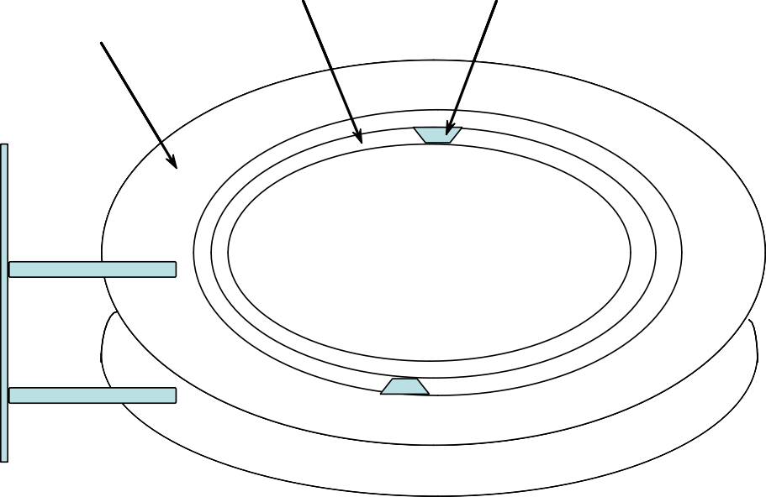
6.1 Objectives of the File Manager
Storage Device
■
Storage Device Organisation
Each storage device (e.g. hard drive, floppy disk, CD, DVD) consists of one or more disks (platters)
Each platter consists of a number of tracks
Each track consists of a number of sectors (or blocks)
Track
Sector
Platter

Slide 7
6.1 Objectives of the File Manager
Storage Device
■
Storage Device Properties
◻ Capacity
Number of platters, number of tracks/platter, number of sectors/track, sector size
Speed
➢
◻
➢
Rotation latency (get to the right sector, 5400, 7200,9600 RPM (rotations per minute)
Arm seek (get to the right track, 1-20 msec) Data transfer (read or write, MB/sec)
➢
➢
■
Disk read & write are done in sectors! => cannot read or write a single byte

Slide 8
6.1 Objectives of the File Manager
■
File Manager provides
◻
◻
directories for organising files. a spectrum of commands
➢
create or delete a file
to read and write the contents of a file, to change the ownership,
to list files in a directory, to remove a file, etc.
➢
➢
➢
◻
◻
a file protection mechanism
sharing of files among users but prevent unauthorised access

Slide 9
6.1 Objectives of the File Manager
■
Criteria for Files organisation
◻
◻
◻
Rapid access to a record (file) Ease to update a file Economy of storage
➢
Should be minimum redundancy in the data
◻
◻
Simple maintenance Reliability

Slide 10
6.2 File Manager: Organising Files
Solutions for organising Files and/or Directories
■
1. Simple Structure
◻
◻
◻
List of entries, one for each file
Sequential file with the name of the file serving as the key Disadvantages:
➢
Provides no help in organising the files ( e.g. no folders/directories)
Forces user to be careful not to use the same name for two different files
➢

Slide 11
6.2 File Manager: Organising Files
Solutions for organising Files and/or Directories
■
2. Two-level Structure
◻
◻
One directory for each user and a master directory Master directory contains entry for each user
➢
Provides address and access control information
◻
◻
Each user directory is a simple list of files for that user Disadvantage:
➢
Still provides no help in structuring collections of files

Slide 12
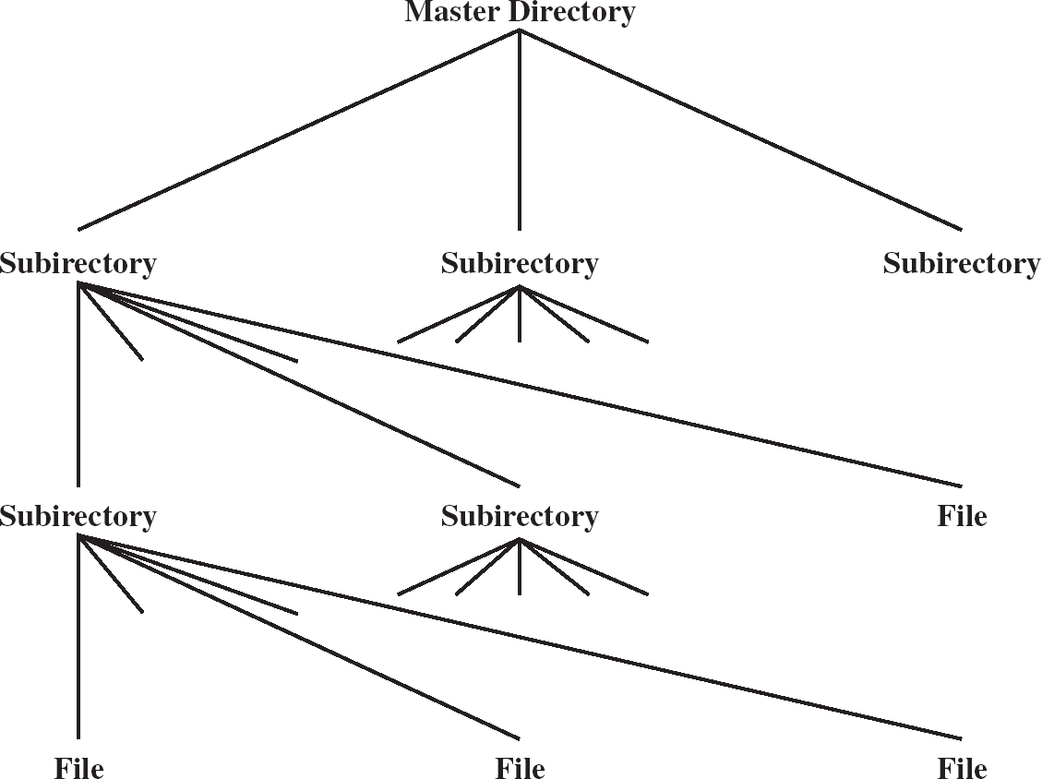
6.2 File Manager: Organising Files
Solutions for organising Files and/or Directories
■
3. Hierarchical or Tree like Structure
◻
◻
Master directory with user directories underneath it
Each user directory may have subdirectories and files as entries
◻
File directory is divided into two levels:
➢
Master File Directory ( MFD) User File Directory
➢

Slide 13
6.2 File Manager: Organising Files
Tree like Structure
■
Master File Directory (MFD)
◻
◻
Contains a listing of all directories on disk
Each user has his own directory and each directory has a unique index number associated with it
=> MFD contains a pointer for each user in the system to a User File Directory (UFD).
◻

Slide 14
6.2 File Manager: Organising Files
Tree Structure
■
User File Directory (UFD)
◻
◻
Contains the names and locations of the user’s files.
Full name of a file is regarded as the user name concatenated with the file name.
➢
Different users may have files with the same name.
E.g. A user (USER1) can find his/her own MYFILE.TXT by referring to it as such.
The file manager assumes the userid in front of the name to map to the exact physical location.
➢
➢
■
Information in the UFD would be
◻
◻
◻
◻
◻
◻
the file name
the physical location of the file
The file type ( e.g. character, binary, executable , library etc)
Program used to operate on the file Access control information ( e.g. read only )
Admin information (e.g. time of last update, last copy taken)

Slide 15
6.2 File Manager: Organising Files
Tree Structure
■
May be more than two levels deep.
■
Disadvantages:
◻
◻
the length of the path to a file
the number of disk accesses required in order to follow the path through the various directories.
■
Improve things a bit with the concept of the ‘current directory’.
◻ Assume individual file names refer to the current directory. To change the current directory you must specify a full path and file name.

Slide 16
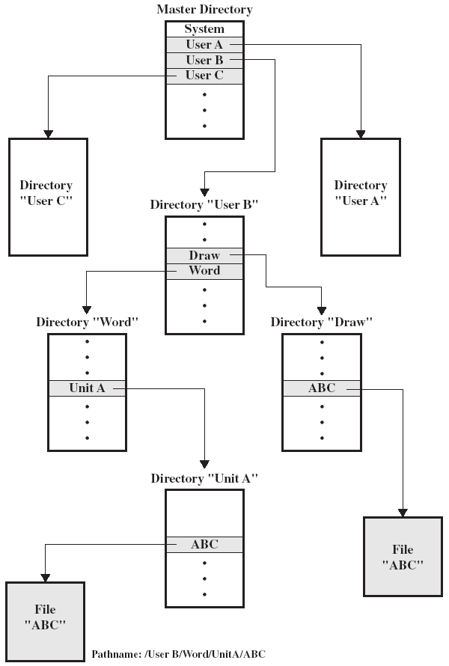
6.2 File Manager: Organising Files
■
Example of Hierarchical or Tree Structure
◻
Master File Directory (MFD) with user directories underneath it
Each user directory (UFD) may have subdirectories and files as entries
◻
■
Files can be located by following a path from the root, or master, directory down various branches
◻
This is the pathname for the file
■
Can have several files with the same file name as long as they have uniqu path names
e
◻
Pathname:
/ User B / Word / Unit A / ABC
Stallings Fig 12.5

Slide 17
6.2 How are File Manager’s Objectives Achieved?
File’s Access. Sharing and Security
■
In a multi-user system, File sharing implies files are accessible to users other than the owner.
Two issues
■
◻
◻
Access rights
Management of simultaneous access
■
When files are to be shared need to specify:
◻
◻
which users are allowed to access the files
what kind of access is permitted.
■
File Manager allows an owner to specify what kind of access is permitted. This is achieved by using a protection mask associated with each file.

Slide 18
6.3 File Manager: File’s Access
Sharing and Security
■
User classes defined within the File Manager
◻
◻
◻
Owner (O)
Group members ( G)
Others ( rest of the world) ( W)
■
Types of access privileges that are associated with a file
◻ None
➢
User may not know of the existence of the file
User is not allowed to read the user directory that includes the file
➢
◻
Read ( R)
➢
The user can read the file for any purpose(e.g. copying, execution)
◻
Write ( W)
➢
The user can modify, delete, and add to the file’s data
◻
Execute ( E)
➢
The user can load and execute a program but cannot copy it

Slide 19
6.3 File Manager: File’s Access
Sharing and Security
■
Owners
◻
◻
Has all rights previously listed
May grant rights to others using the following classes of users
➢
Specific user User groups
All for public files
➢
➢
■
Example: When a new file is created it might be assigned a mask as follows: O:RWE, G:RW, W:R.
■
It means that:
◻
◻
◻
Owner has all privileges - can do anything
Users within the same group as the owner can read and write Others can Read.

Slide 20
6.4 Organisation of Files on the Secondary
Storage
■
Files are stored on the secondary storage
◻
e.g. hard disk, CD, diskette, DVD, etc.
■
These storage devices are divided into blocks
◻ Size of one block: 512 to 4096 bytes
■
Operating System’s File Manager allocates an appropriate number of blocks to each file in order to store the data.

Slide 21
6.4 Organisation of Files on the Secondary
Storage
■
Numerous ways of organising blocks within a file. Four of them are considered here:
◻
◻
◻
Contiguous files
Block linkage
Index blocks
■
OS may use a combination of these for different circumstances
◻ e.g. different media – DVD, CD, hard disk.

Slide 22
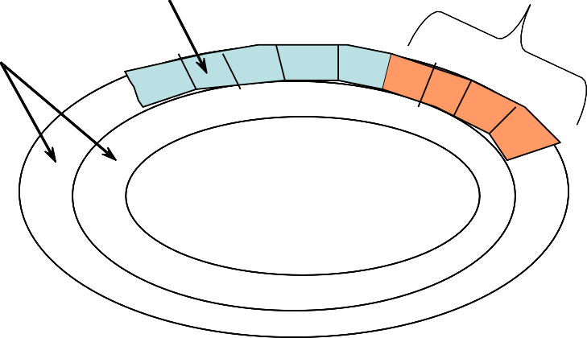
6.4 Organisation of Files on the Secondary
Storage
1. Contiguous Files
■
How it works?
◻
◻
◻
◻
A single set of blocks is allocated to a file at the time of creation Data in a file is stored in a contiguous section of the disk
=> The file occupies a linear sequence of disk blocks User File Directory (UFD) holds for each file:
➢
the file name
start block number the file size
Sector consisting of a block of data
➢
Data from a file
➢
Track
■
Free space
◻ Each set of consecutive blocks that are not used by a file forms a separate free space

Slide 23
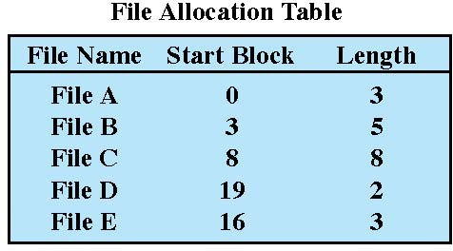
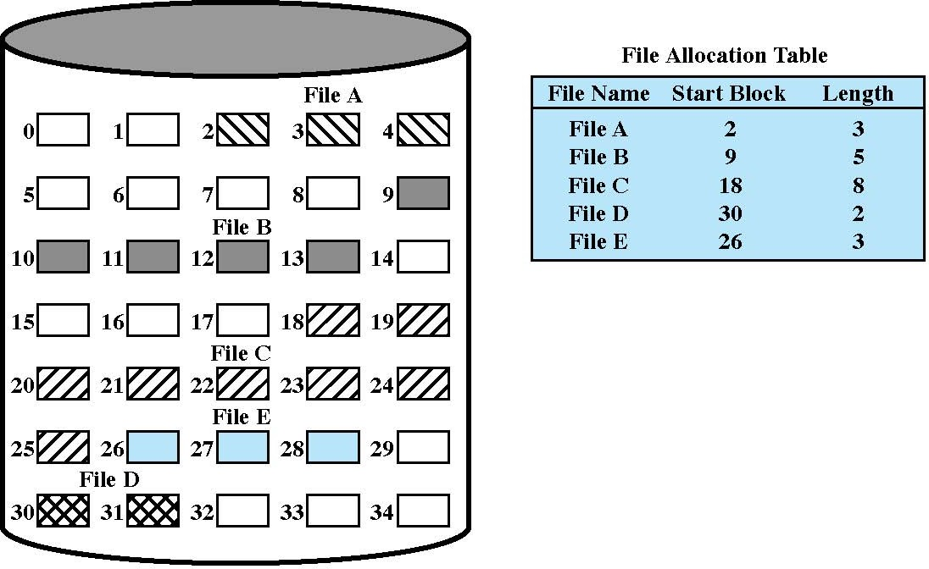
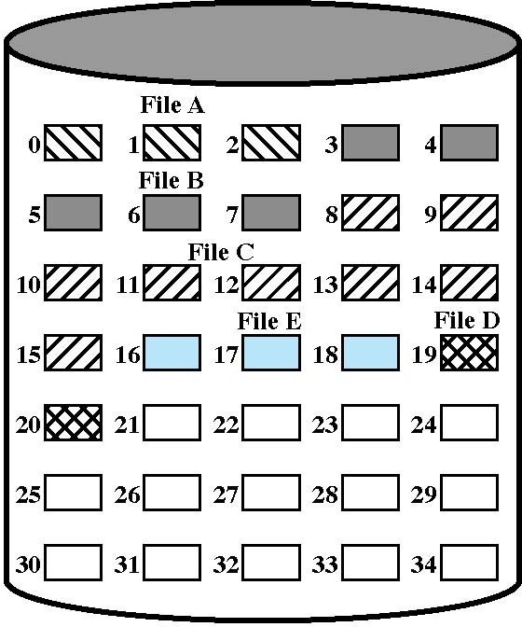
6.4 Organisation of Files on the Secondary Storage
1. Contiguous Files
◻
External fragmentation may occur
compaction needed
Contiguous File Allocation
(Stallings Fig 12.7)
Contiguous File Allocation (After Compaction)
(Stallings Fig 12.8)

Slide 24
6.4 Organisation of Files on the Secondary
Storage
1. Contiguous Files
■
Advantages
◻
◻
◻
◻
Simple to implement
Fast Read and Write operations
Damage to a block results in loss of data only on that block Allows linear and sequential access with the same ease
■
Disadvantages
◻ Fragmentation of the disk space can occur => compaction is required
Compaction requires exclusive use of the file system for an extended time. This is a time consuming process!
Does not allow simple expansion of files. How do you allocate space at the start when you don’t know how the file is going to grow
◻
◻

Slide 25
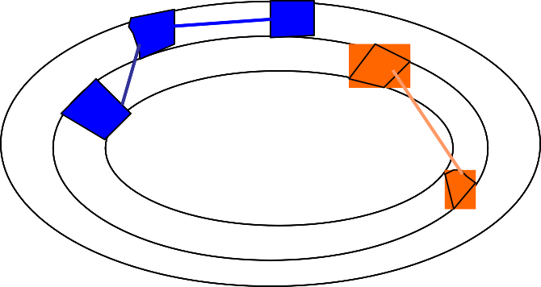
6.4 Organisation of Files on the Secondary
Storage
2. Block linkage
■
How it works?
◻
◻
◻
Sectors belonging to the same file form a linked list
Data blocks of a file can be scattered anywhere on the disk UFD holds for each file:
➢
the file name
start block number
➢
◻
Each data block uses some bytes of its space for a pointer to the next block of the file. This continues until the last block that has a special end-of-file (EOF) value.
■
Free space
◻
◻
A list of free blocks
Blocks that become free are added at either end of the list

Slide 26
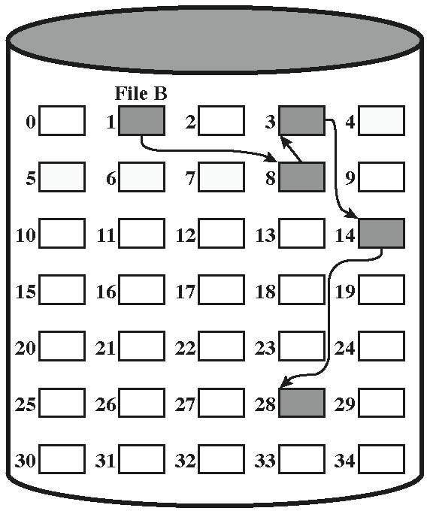
6.4 Organisation of Files on the Secondary Storage
2. Block linkage
File Allocation Table
File Name Start Block
. . .
File B
. . .
. . . 1
. . .
Block linkage
(Stallings Fig 12.9)
EOF
Value

Slide 27
6.3 Organisation of Secondary Storage
2. Block linkage
■
Advantages
◻
◻
◻
◻
◻
Reasonably simple to implement
Files can grow and shrink with no problems
No need to declare the file size when the file is first created No fragmentation => no need to compact free space
Small overhead per block ( pointer to next block )
■
Disadvantages
◻
◻
◻
◻
Large number of accesses to find end of file Deletion of file requires large number of accesses Only sequential access is possible
Damage to a block means loss of link to next block

Slide 28
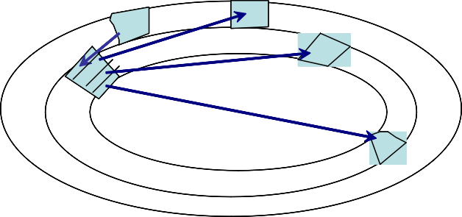
6.3 Organisation of Secondary Storage
3. Index Blocks
■
How it works?
◻
◻
An index block is allocated for each file that is created.
The index block of a file contains all the pointers that point to the data blocks of that file
Index block contains list of blocks for each file
◻
◻
UFD holds for each file:
Block of data
➢
the file name
the index block number
➢
. . .
. . .
■
Free space
Index Block
◻
◻
An index block of free blocks
Pointers to the blocks that become free are added at the end of the index block of the free space

Slide 29
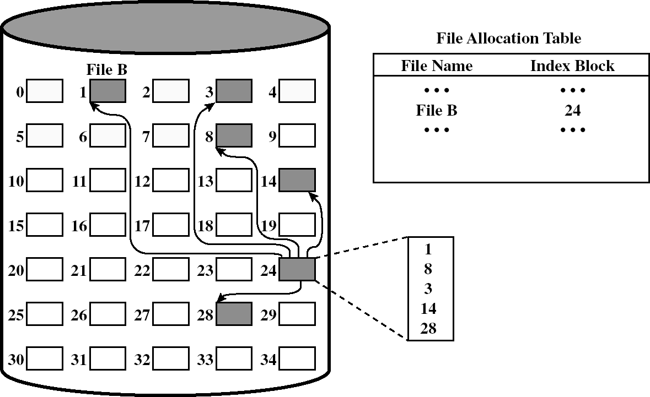
6.3 Organisation of Secondary Storage
3. Index Blocks
Indexed Blocks Allocation
(Stallings Fig 12.11 )

Slide 30
6.4 Organisation of Files on the Secondary
Storage
3. Index Blocks
■
Advantages
◻ File can be accesses randomly specifying file name and offset in index block
Direct-access to the data is efficient. The 'i'th entry in the index block points to the 'i'th block of the file
◻
■
Disadvantages
◻ An entire disk block must be allocated to hold the pointers. Overhead of index blocks
➢
dis-proportionately large for small files
◻
Addition or deletion of blocks in the middle of the file requires rearrangement of pointers
Damage to an index block results in severe data loss
◻

Slide 31
6.4 Organisation of Files on the Secondary
Storage
Free Space Management
■
Regard free space as a file in its own right and handle it under one of the 3 methods above.
The simplest method is to have a bit map representing the disk which shows which blocks are free.
■
■
Other solutions: same techniques used for organising blocks within a file
◻
◻
◻
Free blocks linkage Index of Free Blocks
Free Block List (similar with Contiguous Files technique)

Slide 32
Learning Outcome
■
After this lecture, you should have an understanding of the File Management Layer (File Manager) of a typical Operating System.
◻
◻
Which are the objectives?
Sharing and security regarding file access
■
You should know about :
◻
Three methods/structures of organising the files and the advantages and disadvantages of each.
➢
Simple structure / two level structure/ Hierarchical structure
◻
3 solutions for organising blocks within a file and the advantages and disadvantages of each.
➢
Contiguous file/ block linkage and linked blocks

